Slide 1

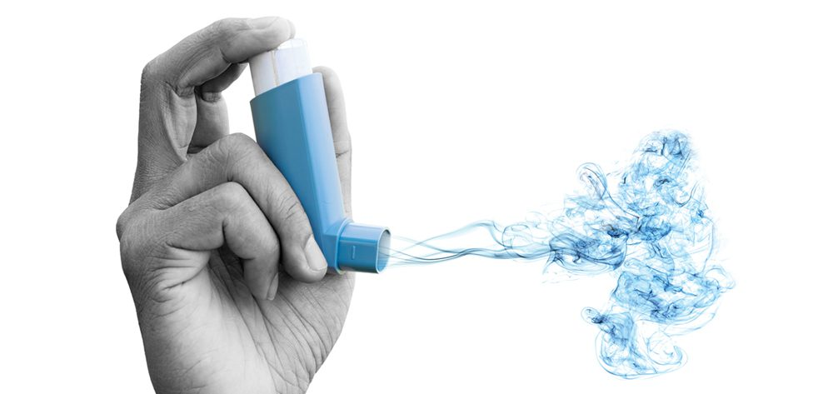
November 2023
MYBREATH – Manage Your Breath
A Machine Learning Approach to predict the risk of an emergent admission from people with asthma

Slide 2


THE PROBLEM
Emergency department visits from people with asthma, associated with the worsening of the chronic condition.
Elevated Healthcare expenditures
Bad patient experience

Slide 3

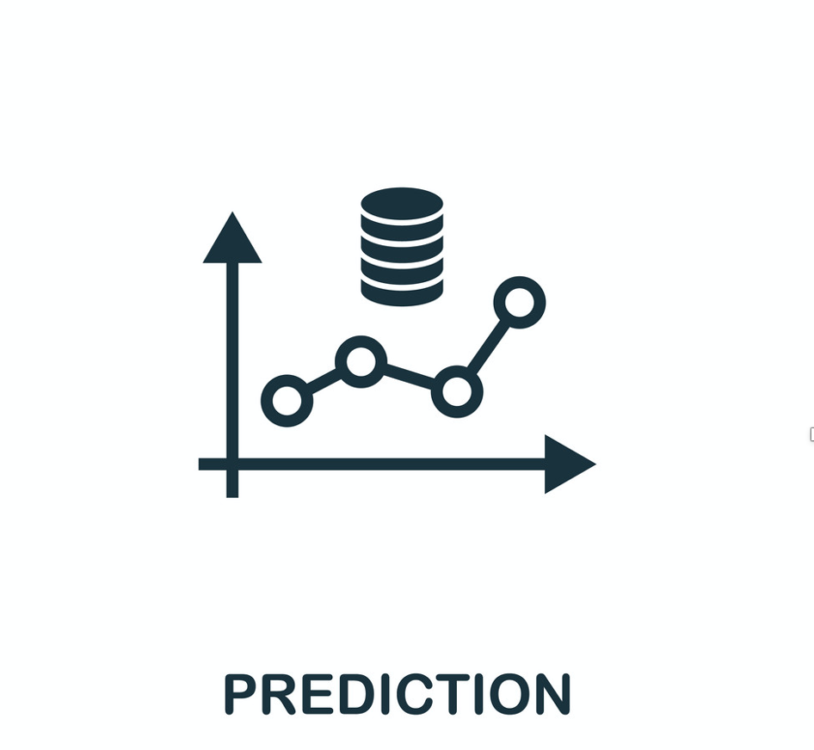



OUR UNIQUE SOLUTION
Machine Learning model to predict the risk of an emergent admission from people with asthma.

Slide 4

KEY METRICS
Accuracy of the model Number of new customers Reduction of hospital admissions of patients with asthma Decrease in the severity of symptoms reported by patients

Slide 5

COST STRUCTURE
Development costs Planning Design Infrastructure Features Testing Maintenance costs Marketing costs

Slide 6

REVENUE STRUCTURE
Individuals: Free app with basic features (with ads) Premium version with more features considers more personalized information; integrates with wearables.

Slide 7

REVENUE STRUCTURE
Partnership with established companies in the health market Healthcare institutions: Commercial contract with healthcare institutions to offer the service to their patients with asthma Maintenance contract

Slide 8





CHANNELS
Conferences and Scientific Societies
Twitter
LinkedIn
Healthcare professionals

Slide 9
PLANNING

